Slide 1

Data Structures

Slide 2

Communication – D2L / Discord
Course Files
Schedule, policies, links, assignments, etc.
Grade book and assignment submissions
Discussion: Q&A
Ask and answer questions – Prof. and T.A. will monitor & contribute
ALL questions on course material should go here
Office Hours: spread throughout the week
Can also reach out to make individual appointments
Notes:
Discussions will be on MS Teams – you can ask questions, and they can be answered by course staff or by fellow students
Please don’t email us unless you have an unusual situation – you’ll get a faster response on MS Teams.
Instructor: Have students log in and connect to the Team
- Show then how to navigate to find files and assignments and schedule

Slide 3
Complexity and Abstraction
Programming is straightforward, as long as your programs are small
Complexity is our enemy
Abstraction is the key to conquering complexity
Abstraction allows us to build general-purpose artifacts
Detail Removal: Hide unnecessary details from users and designers
Generalization: Avoid unnecessary repetitive work
Learning to reason using the most appropriate abstraction is a key goal of computational thinking
Notes:
…to deal with complexity.
If you just want to draw a few things, it’s straightforward. But as it gets more complex, there’s a lot more “stuff” that you need to contend with.
Detail removal: only expose the parts that are necessary for the task at hand
Generalization: don’t reinvent the wheel, try to apply existing tools to similar but new problems
What is the most appropriate abstraction that allows you to solve a problem?
We’ll start with detail removal.

Slide 4


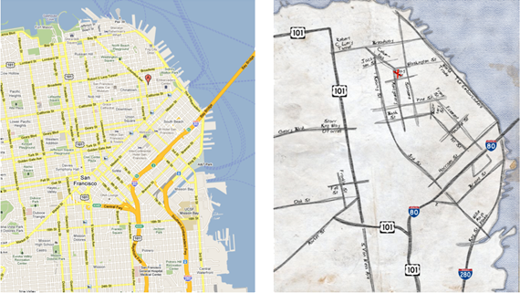
Abstraction: Detail Removal
“The act or process of leaving out of consideration one or more properties of a complex object so as to attend to others.”
Henri Matisse “Naked Blue IV”
Maps for directions
Notes:
Read out quote
What is missing from each of these examples?
1: missing features – how can tell that it’s a person? Has legs, head, etc., even though missing details that a real person would have
2: missing trees/buildings/people/etc. (not necessary for purpose)
3: missing small streets (what if google maps is down – how much detail can we remove and still solve the problem at hand? Don’t even need most of the streets)

Slide 5

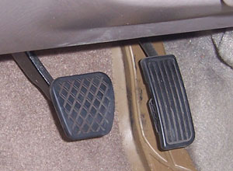
Abstraction: Detail Removal
Detail removal example:
Modern user interface: Right pedal is “accelerate”, left is “decelerate”
Even as underlying technology has changed, this abstraction has not!
Computer controlled fuel injection
Anti-lock brakes (ABS)
Electric cars
Notes:
Who knows what these do?
Who knows the details behind how these work?

Slide 6
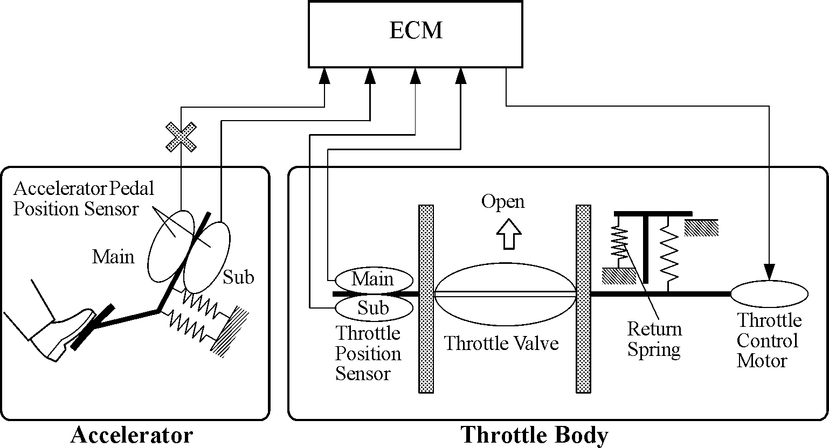
Abstraction: Detail Removal
Detail removal example:
Hide unnecessary details from other designers
e.g. Engine Control Module (ECM) designer doesn’t care about the return spring inside the Throttle!
Notes:
Detail removal also applies to how the car is designed
People who design accelerator pedal don’t even need to know the people who design the piece that actually sends fuel to the engine
“abstraction barrier” between accelerator and throttle body – don’t need to understand details of each other

Slide 7
Abstraction: Detail Removal
Detail removal example:
Hide unnecessary details from other designers
e.g. Engine Control Module (ECM) designer doesn’t care about the return spring inside the Throttle!
Nice to be able to think of a system as a hierarchy of well defined “chunks” with precise functionality
In CS, we say that we have a separation of concerns
Engine Control Module
Accelerator
Throttle
Notes:
ECM serves as “abstraction barrier” between accelerator and throttle – designer of each part isn’t concerned with how the other ones work, as long as it can send/receive data to/from them.

Slide 8
Abstraction: Generalization
“The process of formulating general concepts by abstracting common properties of instances.”
Extensible shower rods
Adjustable hats and belts
Single recipe for <fruit> cheesecake
Feeding animals on a farm
To feed <animal>, put <animal> food in <animal> dish
Your brain generalizes every day, without you even consciously realizing it!
Notes:
Read quote
Shower rods: not every bathroom same size, but instead of building a rod for every single bathroom, just make one that’s extendable
Same for hats/belts
Dealing with situations: when making recipes, can substitute ingredients like fruit while keeping the majority of the recipe the same
Feeding animals: just substitute animal name for each food type
One generalizable solution for all situations

Slide 9
Audience Responses
Other examples of detail removal:
Other examples of generalization:
Notes:
Detail removal:
Flying an airplane (autopilot)
Using a computer (press button)
Light switches
Generalization
Writing programmed formula
General sizing in clothing (S/M/L) instead of exact measurements

